Slide 1
Operating System with Linux as case study
Module 1.1

Slide 2
Introduction to Operating System

Slide 3
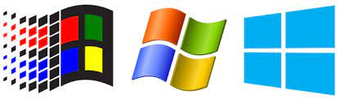


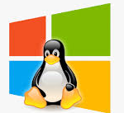
What is an Operating System?
A program that acts as an intermediary between a user of a computer and the computer hardware.
Operating system goals:
  Execute user programs and make solving user problems easier.
  Make the computer system convenient to use.
  Use the computer hardware in an efficient manner.

Slide 4
Operating system : Definition
An Operting System is the low-level software that supports a computer's basic functions, such as scheduling tasks and controlling peripherals.
An operating system is a program that acts as an interface between the user and the computer hardware and controls the execution of all kinds of programs.
An operating system (OS) is system software that manages computer hardware, software resources, and provides common services for computer programs.

Slide 5
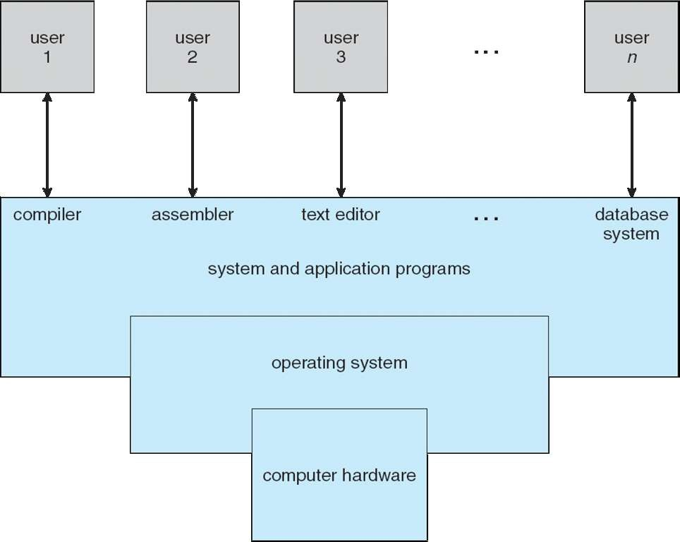
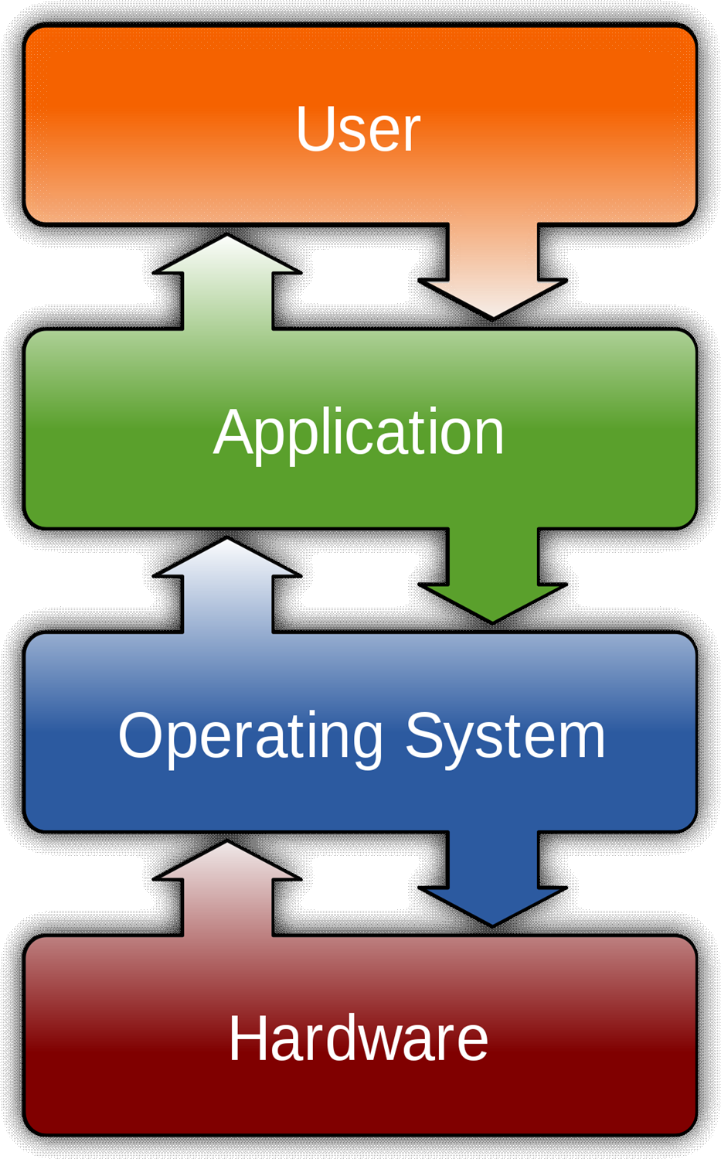

The dominant desktop operating system is Microsoft Windows with a market share of around 82.74%. macOS by Apple Inc. is in second place (13.23%), and the varieties of Linux are collectively in third place (1.57%).

Slide 6
Functions of Operating Systems

Slide 7
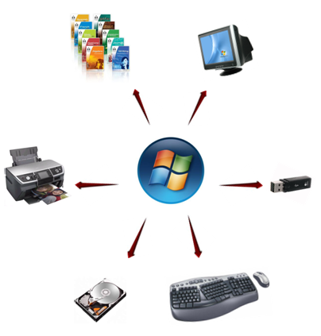
Functions
Memory Management
Security
Control over system performance
Job accounting
Error detection
Coordination between other software and users
Processor Management
Device Management
File Management

Slide 8
Memory Management
The operating system manages the Primary Memory or Main Memory. Main memory is made up of a large array of bytes or words where each byte or word is assigned a certain address.
Main memory is fast storage and it can be accessed directly by the CPU. For a program to be executed, it should be first loaded in the main memory.
An operating system manages the allocation and deallocation of the memory to various processes and ensures that the other process does not consume the memory allocated to one process.
An Operating System performs the following activities for Memory Management:
It keeps track of primary memory, i.e., which bytes of memory are used by which user program. The memory addresses that have already been allocated and the memory addresses of the memory that has not yet been used.
In multiprogramming, the OS decides the order in which processes are granted memory access, and for how long.
It Allocates the memory to a process when the process requests it and deallocates the memory when the process has terminated or is performing an I/O operation.

Slide 9
Security
The operating system uses password protection to protect user data and similar other techniques. it also prevents unauthorized access to programs and user data.
Control over system performance
Monitors overall system health to help improve performance. records the response time between service requests and system response to have a complete view of the system health. This can help improve performance by providing important information needed to troubleshoot problems.
Job accounting
Operating system keeps track of time and resources used by various tasks and users, this information can be used to track resource usage for a particular user or group of user.

Slide 10
Error detection
Operating system constantly monitors the system to detect errors and avoid the malfunctioning of computer system.
Coordination between other software and users
Operating systems also coordinate and assign interpreters, compilers, assemblers and other software to the various users of the computer systems.
Processor Management
In a multi programming environment, the OS decides the order in which processes have access to the processor, and how much processing time each process has. This function of OS is called process scheduling. An operating system performs the following activities for processor management.
Keeps tracks of the status of processes. The program which perform this task is known as traffic controller. Allocates the CPU that is processor to a process. De-allocates processor when a process is no more required.

Slide 11
Device Management
An OS manages device communication via their respective drivers. It performs the following activities for device management. Keeps tracks of all devices connected to system. designates a program responsible for every device known as the Input/Output controller. Decides which process gets access to a certain device and for how long. Allocates devices in an effective and efficient way. Deallocates devices when they are no longer required.
File Management
A file system is organized into directories for efficient or easy navigation and usage. These directories may contain other directories and other files. An operating system carries out the following file management activities. It keeps track of where information is stored, user access settings and status of every file and more… These facilities are collectively known as the file system.

Slide 12
Operating System Services

Slide 13
Program Execution
The operating system is responsible for execution of all types of programs whether it be user programs or system programs. The operating system utilizes various resources available for the efficient running of all types of functionalities.
Handling Input/Output Operations
The operating system is responsible for handling all sort of inputs, i.e, from keyboard, mouse, desktop, etc. The operating system does all interfacing in the most appropriate manner regarding all kind of inputs and outputs.
For example, there is difference in nature of all types of peripheral devices such as mouse or keyboard, then operating system is responsible for handling data between them.

Slide 14
Manipulation of File System
The operating system is responsible for making of decisions regarding the storage of all types of data or files, i.e, floppy disk/hard disk/pen drive, etc. The operating system decides as how the data should be manipulated and stored.
Error Detection and Handling
The operating system is responsible for detection of any types of error or bugs that can occur while any task. The well secured OS sometimes also acts as countermeasure for preventing any sort of breach to the computer system from any external source and probably handling them.

Slide 15
Resource Allocation
The operating system ensures the proper use of all the resources available by deciding which resource to be used by whom for how much time. All the decisions are taken by the operating system.
Accounting
The operating system tracks an account of all the functionalities taking place in the computer system at a time. All the details such as the types of errors occurred are recorded by the operating system.
Information and Resource Protection
The operating system is responsible for using all the information and resources available on the machine in the most protected way. The operating system must foil an attempt from any external resource to hamper any sort of data or information.

Slide 16
Types of Operating Systems

Slide 17
Types of OS
Batch Operating System
Time-Sharing Operating System
Embedded Operating System
Multiprogramming Operating System
Network Operating System
Distributed Operating System
Multiprocessing Operating System
Real-Time Operating System

Slide 18
Batch Operating System
In Batch Operating System, there is no direct interaction between user and computer.
Therefore, the user needs to prepare jobs and save offline mode to punch card or paper tape or magnetic tape.
After creating the jobs, hand it over to the computer operator; then the operator sort or creates the similar types of batches like B2, B3, and B4.
Now, the computer operator submits batches into the CPU to execute the jobs one by one.
After that, CPUs start executing jobs, and when all jobs are finished, the computer operator provides the output to the user.

Slide 19
Time-Sharing Operating System
It is the type of operating system that allows us to connect many people located at different locations to share and use a specific system at a single time.
The time-sharing operating system is the logical extension of the multiprogramming through which users can run multiple tasks concurrently.
Furthermore, it provides each user his terminal for input or output that impacts the program or processor currently running on the system. It represents the CPU's time is shared between many user processes. Or, the processor's time that is shared between multiple users simultaneously termed as time-sharing.

Slide 20
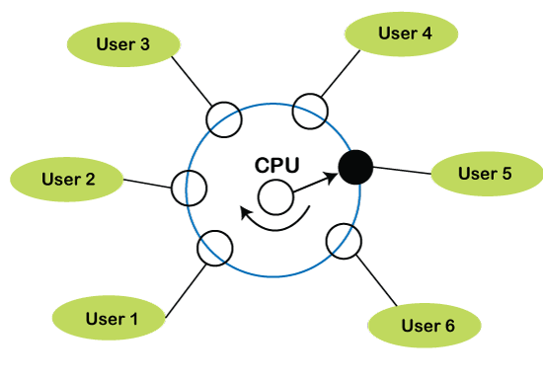
Time-Sharing Operating System

Slide 21
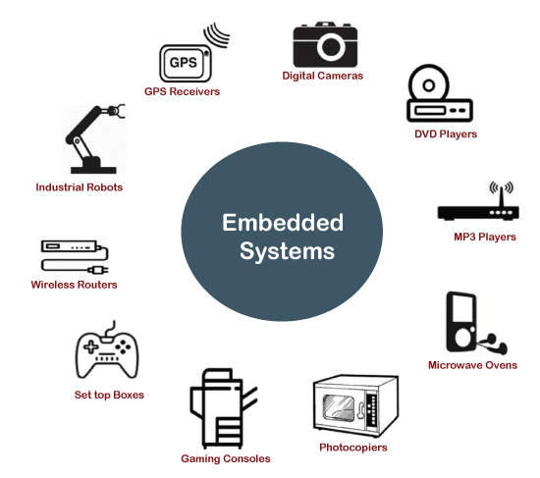
Embedded Operating System
The Embedded operating system is the specific purpose operating system used in the computer system's embedded hardware configuration. These operating systems are designed to work on dedicated devices like automated teller machines (ATMs), airplane systems, digital home assistants, and the internet of things (IoT) devices.

Slide 22
Multiprogramming Operating System
Due to the CPU's underutilization and the waiting for I/O resource till that CPU remains idle.
It shows the improper use of system resources. Hence, the operating system introduces a new concept that is known as multiprogramming.
A multiprogramming operating system refers to the concepts wherein two or more processes or programs activate simultaneously to execute the processes one after another by the same computer system.
When a program is in run mode and uses CPU, another program or file uses I/O resources at the same time or waiting for another system resources to become available.
It improves the use of system resources, thereby increasing system throughput. Such a system is known as a multiprogramming operating system.

Slide 23
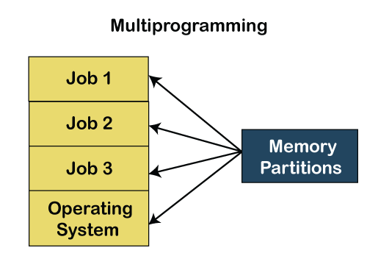
Multiprogramming Operating System

Slide 24
Network Operating System
A network operating system is an important category of the operating system that operates on a server using network devices like a switch, router, or firewall to handle data, applications and other network resources.
It provides connectivity among the autonomous operating system, called as a network operating system.
The network operating system is also useful to share data, files, hardware devices and printer resources among multiple computers to communicate with each other.

Slide 25
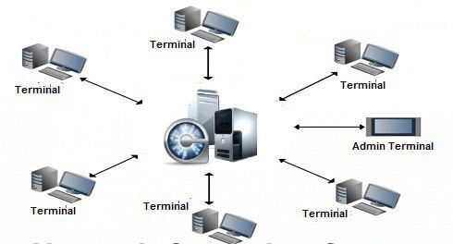
Network Operating System

Slide 26
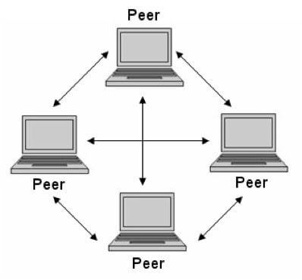
Types of network operating system
Peer-to-peer network operating system: The type of network operating system allows users to share files, resources between two or more computer machines using a LAN.

Slide 27
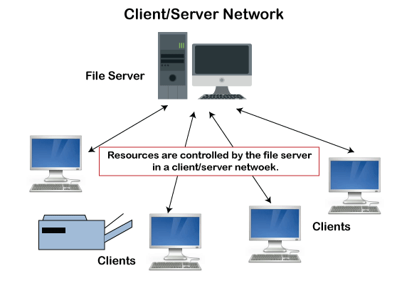
Types of network operating system
Client-Server network operating system: It is the type of network operating system that allows the users to access resources, functions, and applications through a common server or center hub of the resources. The client workstation can access all resources that exist in the central hub of the network. Multiple clients can access and share different types of the resource over the network from different locations.

Slide 28
Distributed Operating system
A distributed operating system provides an environment in which multiple independent CPU or processor communicates with each other through physically separate computational nodes.
Each node contains specific software that communicates with the global aggregate operating system. With the ease of a distributed system, the programmer or developer can easily access any operating system and resource to execute the computational tasks and achieve a common goal.
It is the extension of a network operating system that facilitates a high degree of connectivity to communicate with other users over the network.

Slide 29
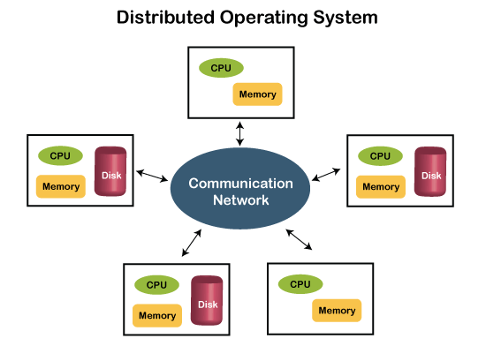
Distributed Operating system

Slide 30
Multiprocessing Operating System
It is the type of operating system that refers to using two or more central processing units (CPU) in a single computer system.
However, these multiprocessor systems or parallel operating systems are used to increase the computer system's efficiency.
With the use of a multiprocessor system, they share computer bus, clock, memory and input or output device for concurrent execution of process or program and resource management in the CPU.

Slide 31
Real-Time Operating System
A real-time operating system is an important type of operating system used to provide services and data processing resources for applications in which the time interval required to process & respond to input/output should be so small without any delay real-time system.
For example, real-life situations governing an automatic car, traffic signal, nuclear reactor or an aircraft require an immediate response to complete tasks within a specified time delay. Hence, a real-time operating system must be fast and responsive for an embedded system, weapon system, robots, scientific research & experiments and various real-time objects.

